Slide 1
Modern India: Journeys of Nation-Building and Global Standing
A Presentation on Modern India

Slide 2
Overview: Unpacking Modern India
Explore India's historical journey from colonial rule to an independent sovereign state post-1947.
Understand the central themes that define modern India, including its diversity, culture, minorities, and urban-rural dynamics.
Examine the challenges and opportunities within India's democracy, economy, and geopolitical role in the world.
Identify key events, personalities, and issues that have profoundly shaped the nation's contemporary identity.
Recognize the foundational role of leaders like Jawaharlal Nehru, the architect of modern India.

Slide 3
The Genesis of an Independent Nation
Modern India's history began with its independence as a sovereign state on August 15, 1947, ending direct British administration.
The period leading to independence includes the decline of the Mughal Empire, British colonial rule, and the vigorous independence movement.
Jawaharlal Nehru, India's first prime minister, addressed a newly independent nation and is regarded as the architect of modern India.
The process of nation-building involved significant efforts to impose a national framework on old and diverse cultural traditions.
This foundational era laid the groundwork for India's future as a democratic republic.

Slide 4
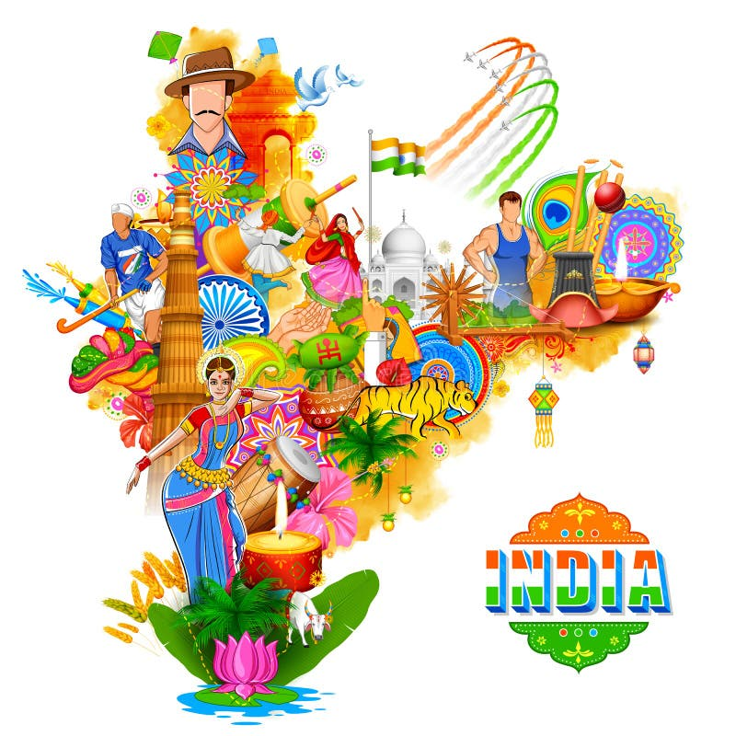
A Tapestry of Diversity and Culture
Diversity stands as a central theme, encompassing a vast array of languages, religions, and ethnic groups across the nation.
India's rich and ancient culture is deeply woven into its national identity and everyday life, influencing all aspects of society.
The role and experiences of minorities are crucial to understanding the complex social fabric and inclusive aspirations of modern India.
The dynamic interaction between urban and rural areas highlights significant aspects of India's development and societal structure.
These five core themes — diversity, culture, minorities, and urban-rural interaction — are essential to comprehending modern India.

Slide 5
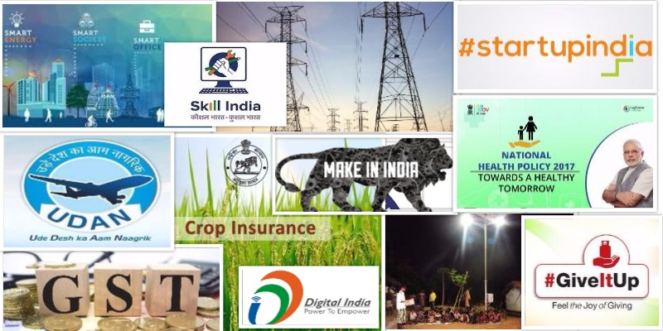
Navigating Democracy, Economy, and Geopolitics
India's vibrant democracy presents both unique opportunities for governance and ongoing challenges in representation and policy implementation.
The national economy experiences dynamic growth, yet also grapples with significant developmental disparities and social inequalities.
India plays an increasingly crucial role in global geopolitics, balancing its national interests with international responsibilities.
The nation continuously explores opportunities to assert its influence while addressing internal and external challenges.
These critical areas define India's evolving position and impact on the global stage.

Slide 6
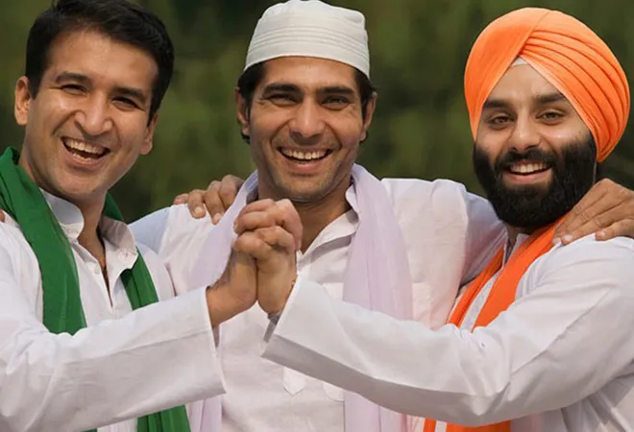
The Evolving State and Society Interface
The modern Indian state continually works to establish a national framework amidst its deeply rooted and varied cultural heritage.
The relationship between the modern Indian state and its indigenous (adivasi) subjects demonstrates a complex history of mutual shaping.
Significant events, personalities, and issues have consistently shaped the direction and character of modern India.
Challenges in nation-building often involve balancing national unity with the preservation of distinct regional and community identities.
This ongoing interaction between governance and diverse populations is fundamental to India's development path.

Slide 7
Modern India: A Continuous Journey
Modern India is a dynamic nation, profoundly shaped by its journey from colonial rule to independence in 1947.
Its identity is intrinsically linked to its immense diversity, rich cultural heritage, and the complex integration of various communities.
India actively navigates significant challenges and opportunities within its democratic system, growing economy, and crucial geopolitical standing.
The continuous evolution of the state, in dialogue with its people and diverse groups, remains central to its future trajectory.
Understanding modern India necessitates appreciating its historical foundations, defining themes, and ongoing transformational journey.

